Slide 1
Software Development Life Cycle (SDLC)
An Overview with Framework and Methods

Slide 2
The need for a framework
Purpose of the systems development function is to develop effective systems in the most efficient way possible.
The traditional systems development life cycle (with which you are all familiar ) was a first attempt to provide a controlled environment for systems development.

Slide 3
Introduction
The Software Development Life Cycle (SDLC) is a process used by software industry to design, develop, and test high-quality software.
It aims to produce software that meets or exceeds customer expectations.

Slide 4
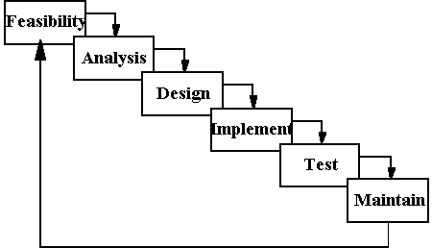
You must remember this!

Slide 5
SDLC Phases
SDLC consists of several phases:
1. Planning
2. Requirements
3. Design
4. Development
5. Testing
6. Deployment
7. Maintenance

Slide 6
Planning Phase
In the planning phase, project goals are determined and high-level planning is done.
Example: Defining the scope and objectives of a new e-commerce website.

Slide 7
Requirements Phase
In the requirements phase, detailed requirements are gathered from stakeholders.
Example: Gathering requirements for user authentication and payment gateway integration.

Slide 8
Example: Requirements Analysis
Investigation of current environment
  Establish analysis framework
  Investigate and define requirements
  Investigate current processing
  Investigate current data
  Derive logical view of current services
  Assemble investigation results
Business System options
  Define business system options
  Select business system options
  Define Requirements

Slide 9
Design Phase
In the design phase, system architecture and design are created.
Example: Designing the database schema and user interface for the e-commerce website.

Slide 10
Development Phase
In the development phase, actual code is written based on the design.
Example: Developing the front-end and back-end functionalities of the e-commerce website.

Slide 11
Testing Phase
In the testing phase, the software is tested to ensure it meets the requirements.
Example: Performing unit testing, integration testing, and user acceptance testing.

Slide 12
Deployment Phase
In the deployment phase, the software is released to the production environment.
Example: Deploying the e-commerce website to a cloud server.

Slide 13
Maintenance Phase
In the maintenance phase, ongoing support and maintenance are provided.
Example: Fixing bugs and adding new features to the e-commerce website.

Slide 14
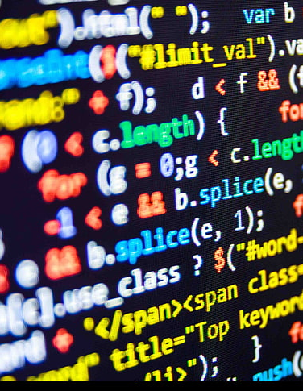
The development Models

Slide 15
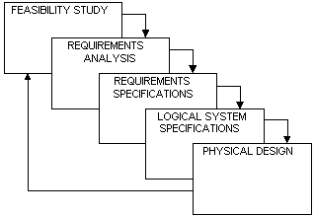
SSADM generic framework

Slide 16
SSADM stages
Each stage has a number of steps
Each step may have a number of substeps
Each stage/step/substep has one or more end deliverables associated with it…..

Slide 17
UML
Unified Modelling Language
Again, not a methodology based upon our definition
  A set of specifications and design notations for object -oriented development
  Developed combining modelling techniques developed by Booch, Rumbaugh and Jakobsen
Lots of methods have been developed from it.

Slide 18
Use case driven
Use cases used here to capture the user requirements
A use case describes an element of the functionality of the system
All the use cases together (the use case model) depicts the total functionality of the system
  The system is designed based upon the use cases
  Implemented to support the use cases
  Tested upon content of the use cases
So, Use cases are very important!

Slide 19
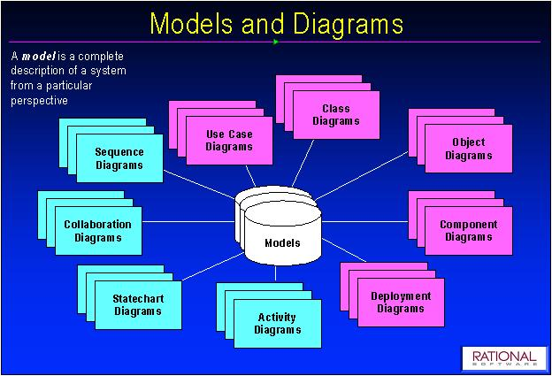
UML models and diagrams

Slide 20
RUP
The Rational Unified Process
“A full-fledged process able to support the entire software development life-cycle”.
“Use case driven, architecture centric, iterative and incremental”

Slide 21
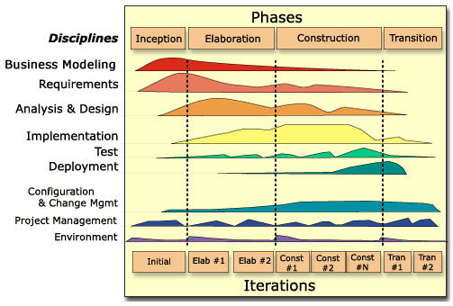
Rational Unified Process

Slide 22
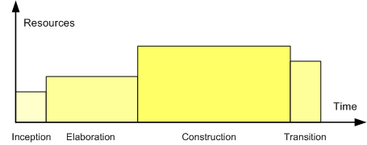
RUP – Phases and resources

Slide 23
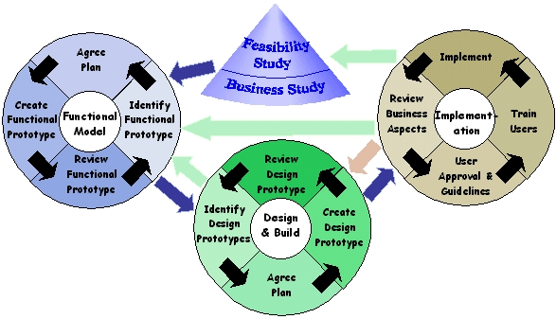
The DSDM life cycle
(Dynamic Systems Development Method)

Slide 24
Agile Methods (1)
Agile methodologies are a family of methodologies, not a single approach to software development.
They are based on the original concepts of Rapid Application Development (RAD)
The idea has been developed to incorporate later stages of the life cycle (software development) and project management
DSDM is an Agile Method developed in the UK

Slide 25
Agile Methods (2)
The Agile Manifesto
  We are uncovering better ways of developing software by doing it and helping others do it. Through this work we have come to value:
    Individuals and interactions over processes and tools
    Working software over comprehensive documentation
    Customer collaboration over contract negotiation
    Responding to change over following a plan
    http://agilemanifesto.org/

Slide 26
Agile Methods (3)
Some of the well-known agile software development methodologies include:
  Extreme Programming (XP)
  Scrum
  Adaptive Software Development (ASD)
  Crystal Clear and Other Crystal Methodologies
  DSDM
  Feature Driven Development
  Lean software development

Slide 27
Agile Methods (4)
Key Agile concepts
  Most agile methods attempt to minimize risk by developing software in short timeboxes, called iterations, which typically last one to four weeks.
  Each iteration is like a miniature software project of its own, and includes all the tasks necessary to release the mini-increment of new functionality: planning, requirements.

Slide 28
Agile Methods (5)
Key Agile concepts cont…
  Agile methods emphasize face-to-face communication over written documents.
  Most agile teams are located in a ‘bullpe’n and include all the people necessary to finish software.
    At a minimum, this includes programmers and their "customers."
    The bullpen may also include testers, interaction designers, technical writers, and managers.

Slide 29
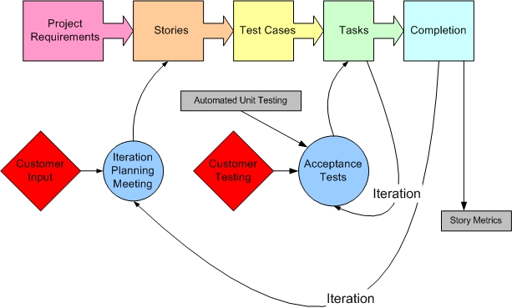
Extreme Programming

Slide 30
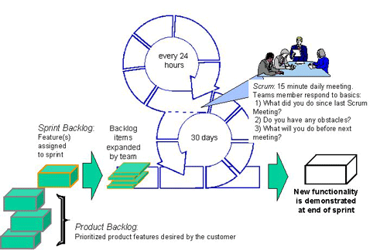
Scrum

Slide 31
Iterative and Incremental
Belief that user requirements cannot be fully and accurately defined at one go.
Requirements evolve and change over time as understanding deepens.
This is a key concept of modern methods and we will come back to it over and over again.

Slide 32
Real-World Example: Planning
Example: Planning the development of a mobile banking app, including defining the scope, objectives, and timeline.

Slide 33
Real-World Example: Requirements
Example: Gathering requirements for features such as account balance check, fund transfer, and transaction history.

Slide 34
Real-World Example: Design
Example: Designing the user interface and database schema for the mobile banking app.

Slide 35
Real-World Example: Development
Example: Developing the front-end and back-end functionalities of the mobile banking app.

Slide 36
Conclusion
SDLC is a crucial process for developing high-quality software. Understanding each phase and its importance helps ensure successful software projects.
Example implementation : Process Model

Slide 37

Task
Work in group of 4.
Propose a system/app
Implement either SCRUM towards completing the proposed project.
Articulate the process and findings in powerpoint converted to PDF (smaller file size).
Share in class.

